Slide 1

Automating Migrations to Cascade CMS
Sean Flynn, Web Developer
William & Mary
#dpa2

Slide 2

About Me!
Web developer for William & Mary Advancement
Previously: HigherEdJobs.com, Penn State, Northwest Florida State College
Primary work in ColdFusion, PHP, AEM, Cascade

Slide 3


What about you?
How many of you are…
Web developers/designers/programmers?
Graphic designers?
Marketing/editorial?
Technical management?

Slide 4
This is a “MID-TECH-level” presentation
This presentation is aimed at programmers and technical management
High-level enough for non-programmers to build comfort with the concepts…
…but we’ll dip into the code and processes enough for programmers to get a good start.

Slide 5

Don’t worry about taking notes!
Example code (and the entire Powerpoint) will be on Github
Shoot me an email: sflynn@wm.edu
Twitter: @wxgeek
github.com/sflynn850/heweb18

Slide 6
What We’ll Cover Today
Where we were, where we wanted to go
Web Scraping
CasperJS 101
Using the Cascade API
Tips & Tricks

Slide 7



The Old System
Our version was being EOLed
Had extensive legacy code that needed to be retooled
To upgrade, or not to upgrade?

Slide 8


Slide 9
The New System
Cascade 8!
Site migration was essentially done …
…except for the 617 news stories

Slide 10
Migration Options
Delve directly into the AEM database (oh no)
Have someone retype 600+ news stories
Some things are too cruel even for interns
Or … web scraping!

Slide 11
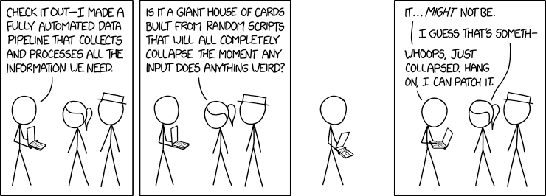
Web Scraping 101

Slide 12
CSS Selectors and You

Slide 13
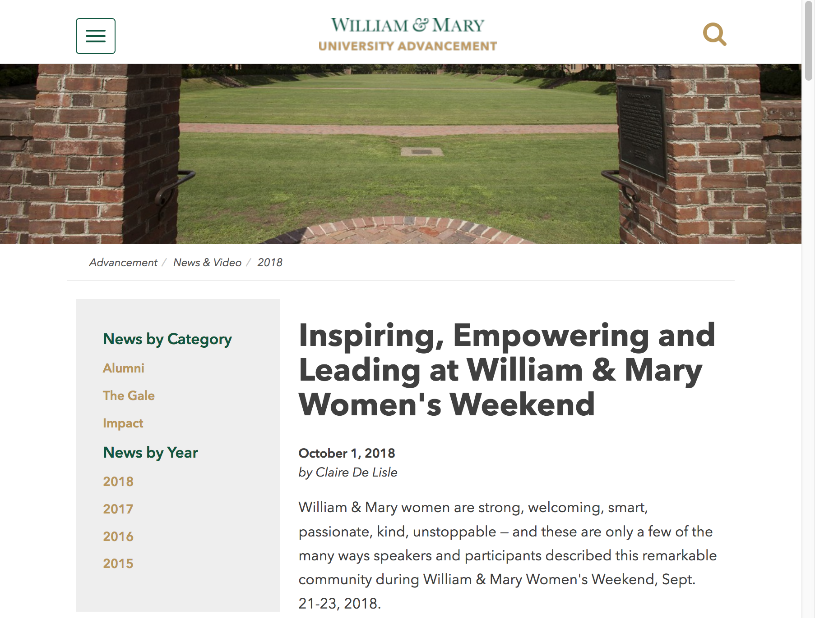

IDs
One per page
id=“someID”
Referenced with #, e.g., #someID
<h1 id=“pageTitle”>Inspiring, Empowering and Leading at William & Mary Women's Weekend</h1>

Slide 14
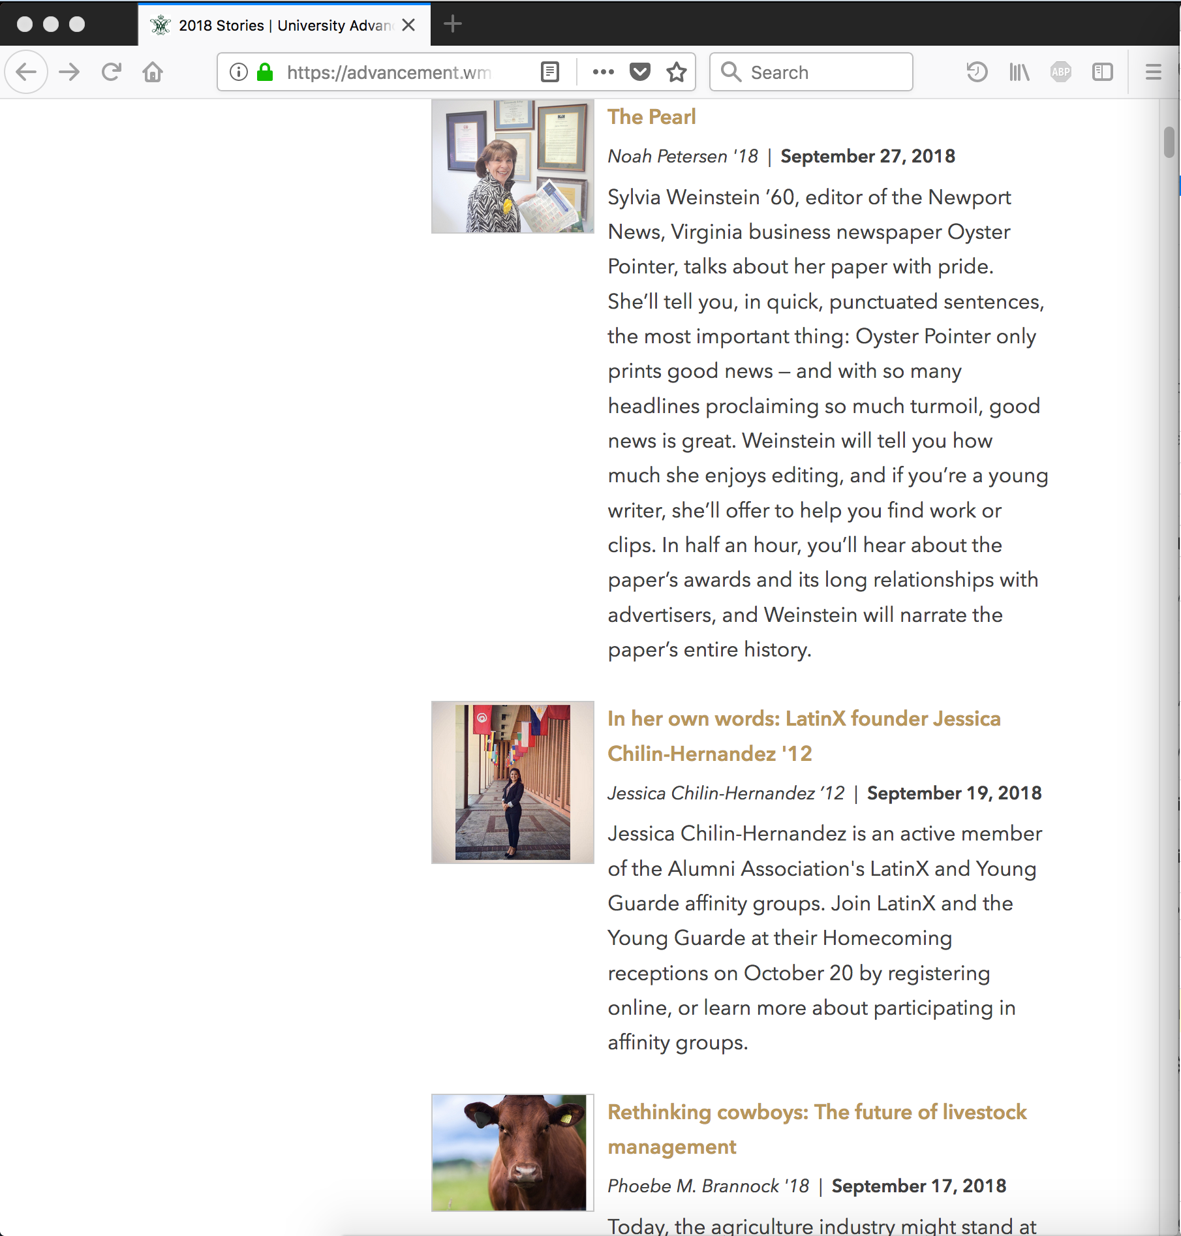

Classes
<article class="news_listing">[…] <a href="oyster-pointer.php" title="The Pearl">The Pearl</a> <div class="article-meta"> <span class="author">Noah Petersen '18</span> <span class="date">September 27, 2018</span> </div> </header> <p>Sylvia Weinstein ’60, editor of the […] </p> </div> </article>

Slide 15
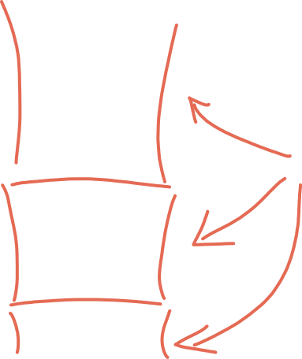
Classes
One or many per page
class=“someClass”
Referenced with ., e.g., .someID
.news_listing

Slide 16
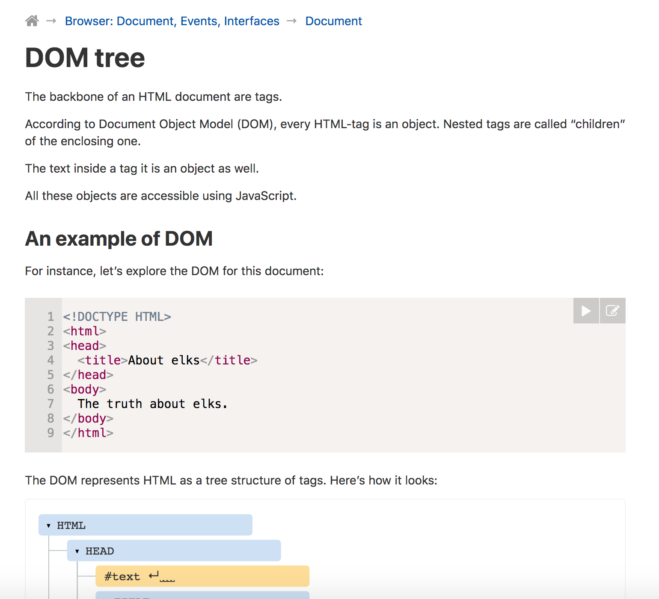
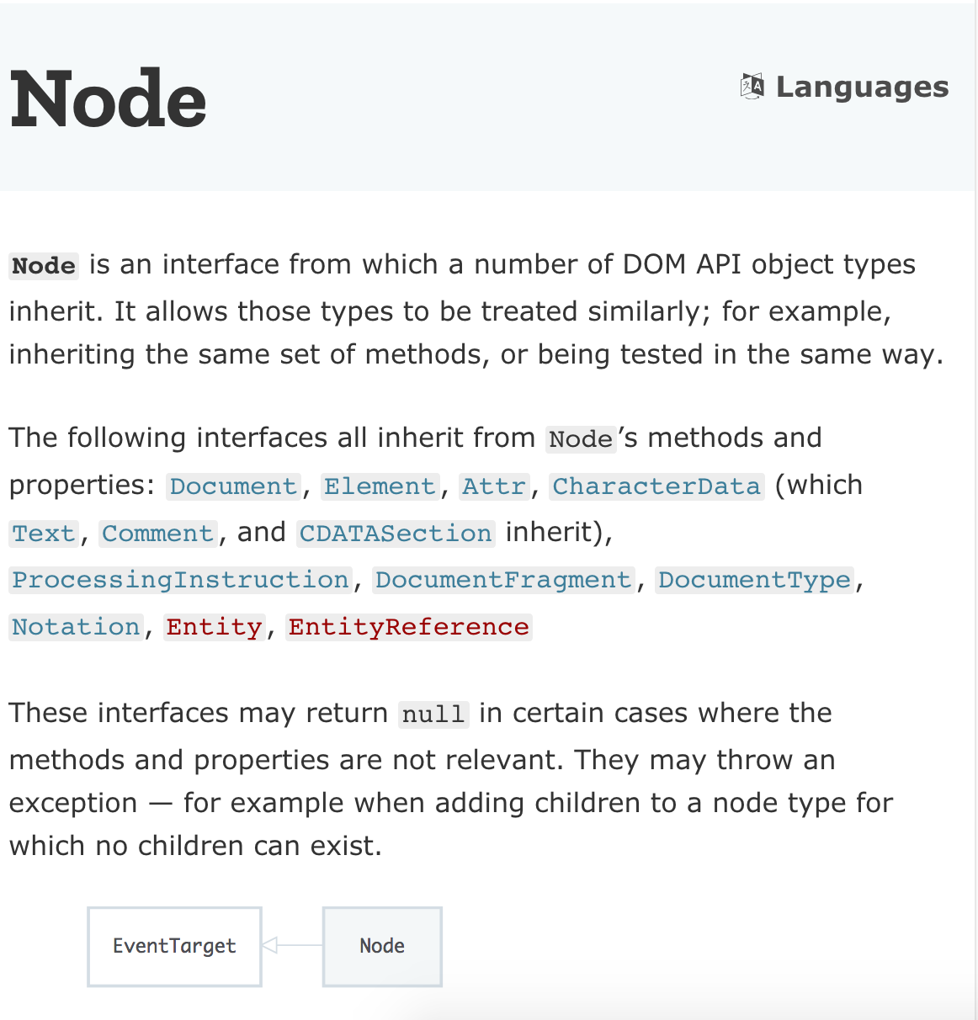

DOM Object Nodes
For more information: https://developer.mozilla.org/en-US/docs/Web/API/Document_Object_Model

Slide 17
Parent and Child Elements
<div id=“parent”>
<p class=“bodyText”>Some <span class=“red”>Text</span> Here</p>
</div>
Select the div:
Select the paragraph:
Select the span inside the paragraph:
#parent
#parent > .bodyText
#parent > .bodyText > .red

Slide 18

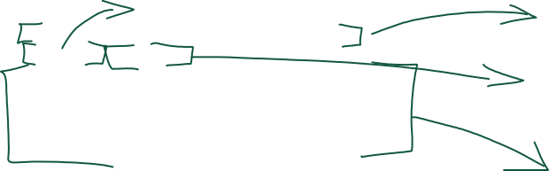
The Index Page: An Overview
Author
Title
Publish date
Body

Slide 19
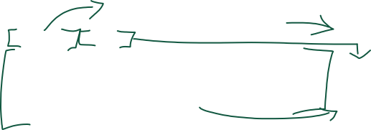
The Index Page: An Overview
header >.article-meta > .author
header > a
header > .article-meta > .date
listing_content > header > p

Slide 20
Web Scraping with CasperJS

Slide 21
CasperJS Overview
Runs on PhantomJS
Lets us craft HTTP requests and execute JavaScript as if we were in a browser
casperjs.org

Slide 22
Installing CasperJS
On a Mac: brew install casperjs
On Windows, Linux PCs: Slightly harder

Slide 23
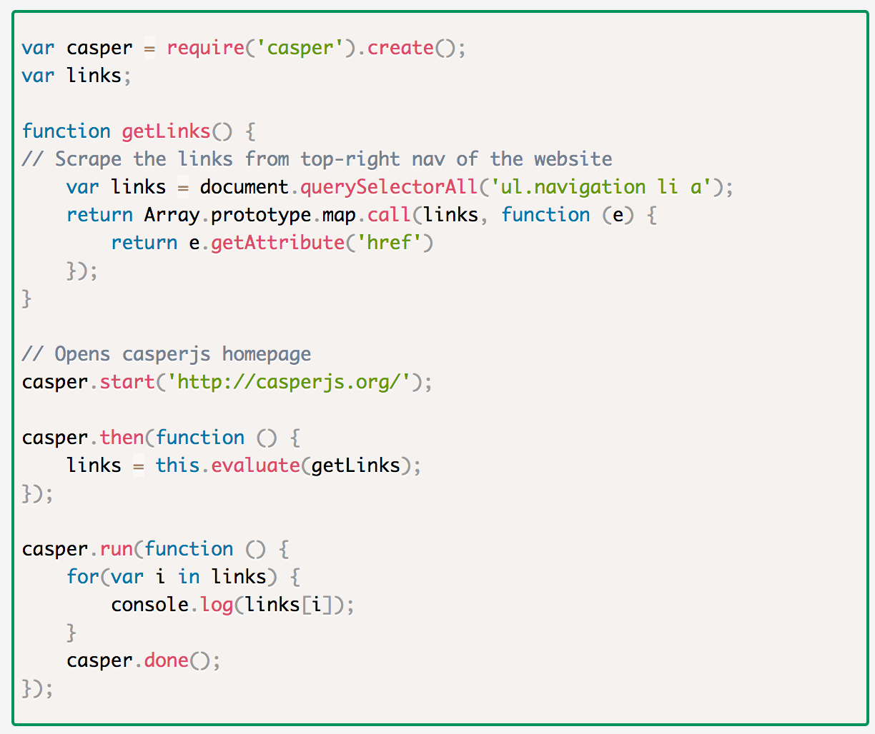
CasperJS Basic Structure

Slide 24
Basic Scraping Strategy: Index Pages
Index Page
Load up the (next?) index page
Find all links
Select all of the links
Links -> Array
Add each link to an array
Next button?
Look for a “next” button. Click it, if there is one — else quit.

Slide 25
Basic Scraping Strategy: Content Pages
Pull the next URL off the top of the array
Load the news article
Parse out the desired fields
Perform any required text modifications
Assemble Cascade API request
Send request
Rinse, Repeat

Slide 26
An Example: galeScraper-distributable.js
This code (and more) is in the Github!
https://github.com/sflynn850

Slide 27
galeScraper-distributable.js
Hit the index
Get a list of links
Iterate over the list
Open each article
Extract content from article
Fix content
Send API request
Rinse, Repeat

Slide 28
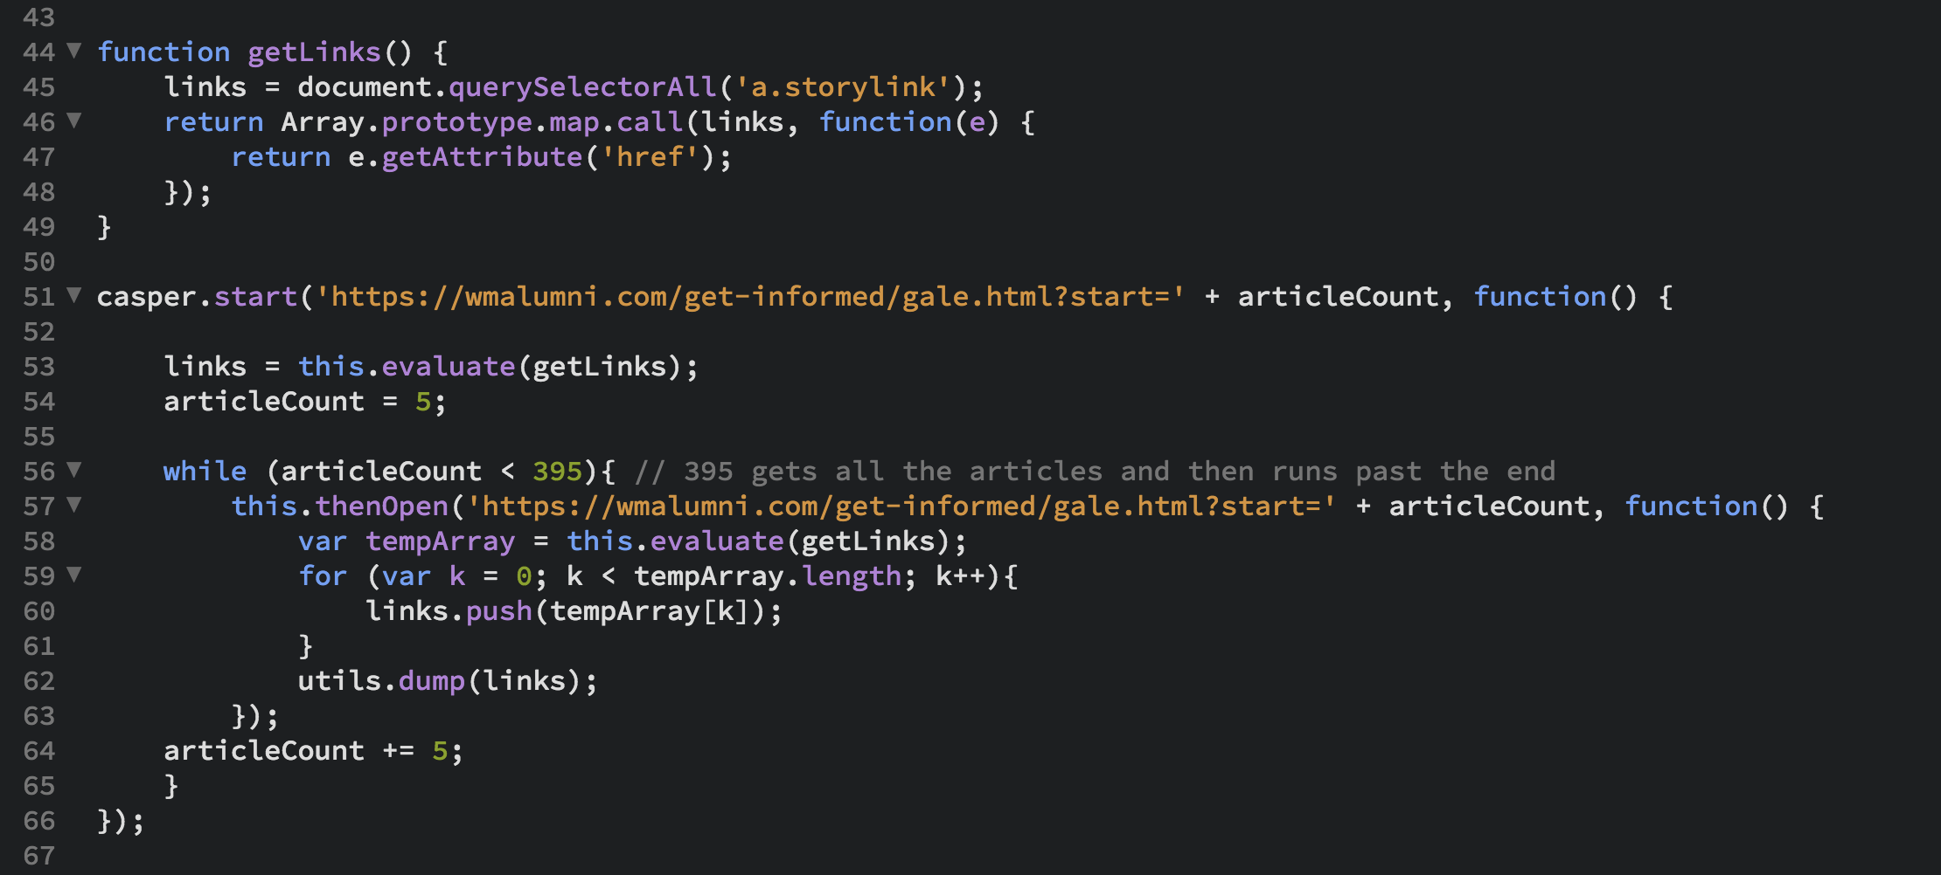

Getting Links

Slide 29
The Best Part of CasperJS: .evaluate
Casper.evaluate
We get to run JS like we were in a browser
Which means we can do all kinds of document.whatever stuff, including (most essentially) document.querySelectorAll
Use querySelectorAll, not regex, to find the content you need. Further reading.
Remember, you have to return one single object out of a .evaluate block

Slide 30
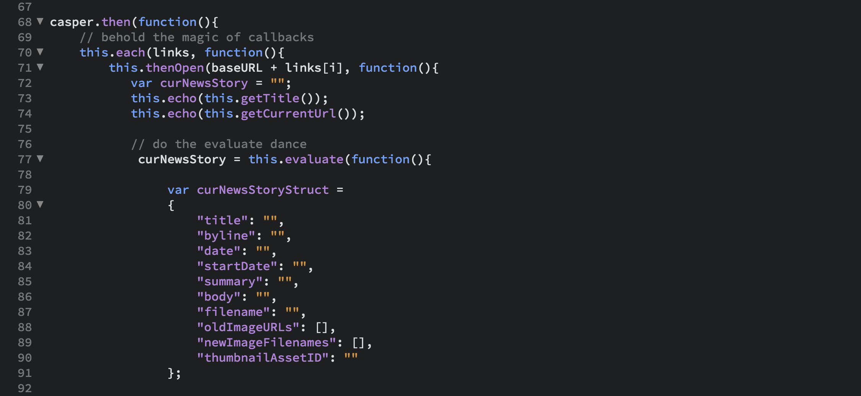

Slide 31
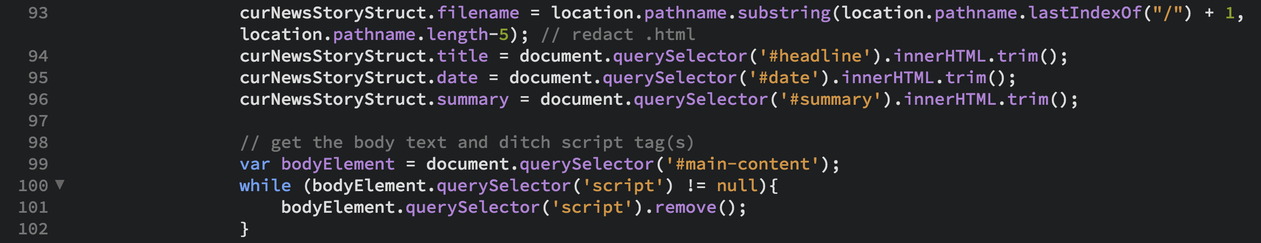
Getting Fields in a .evaluate block

Slide 32
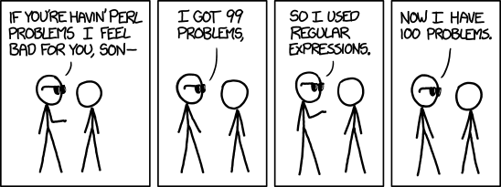
Cleaning Text With Regex

Slide 33
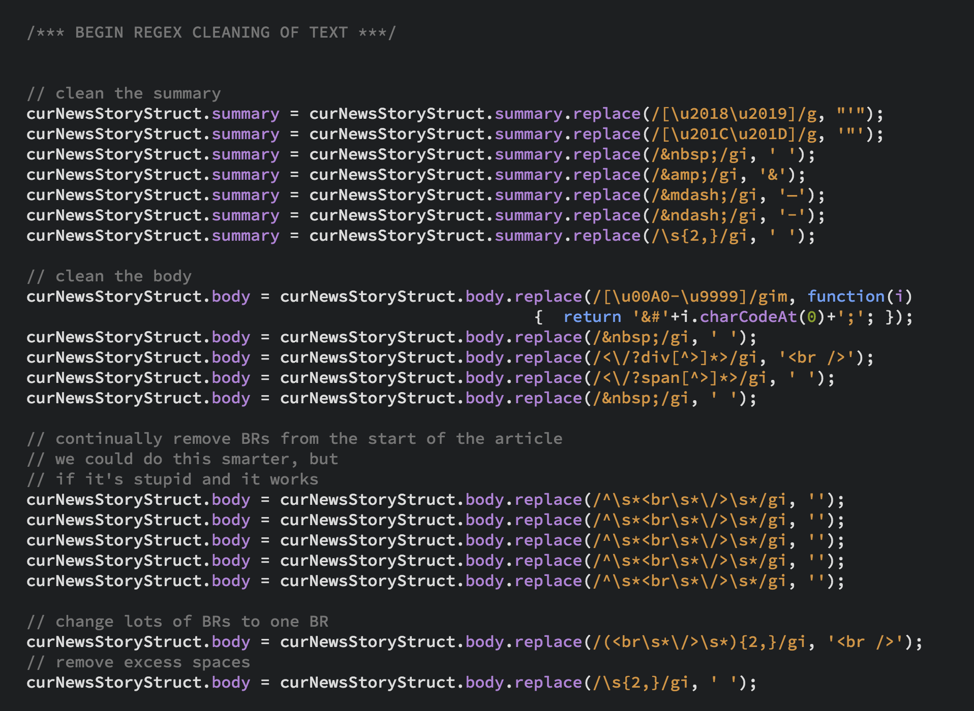

Slide 34
Cascade API
We’ll use Cascade’s REST API to insert stories into the CMS
API documentation is a little sparse
The best way to craft a “Create” packet is to read a node and create your JSON object from there.
Example READ url:
https://cascade.wm.edu/api/v1/read/folder/www.wm.edu/giving/_redirects/_response/?u=***&p=***
User needs permission to read the object!

Slide 35
JSON Structure of a Cascade API Request

Slide 36
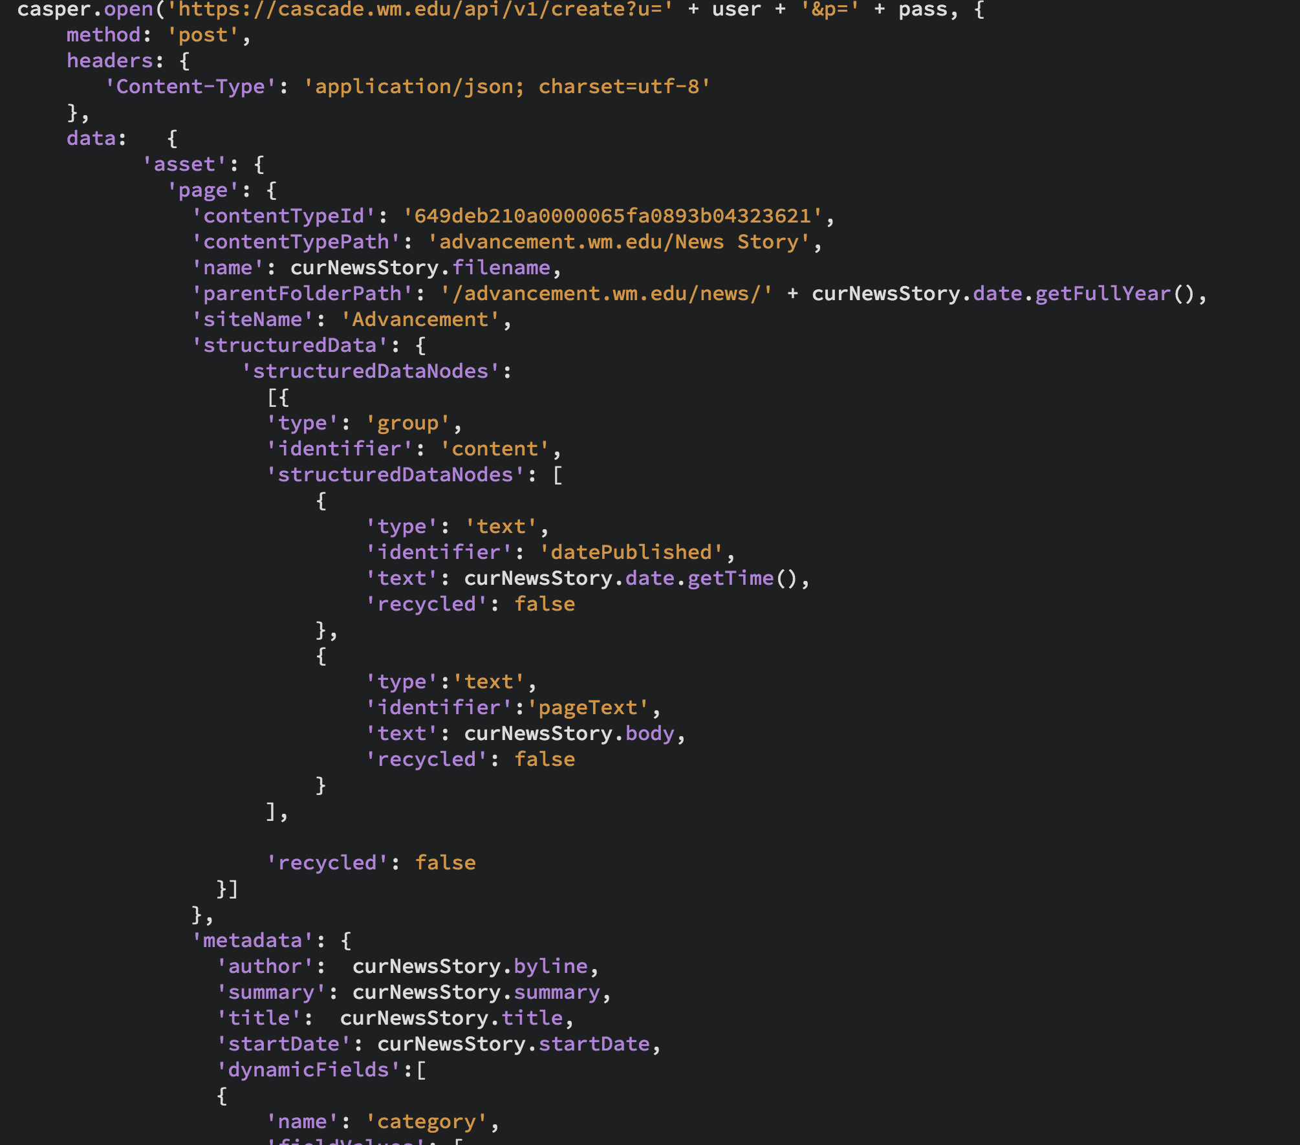

Slide 37
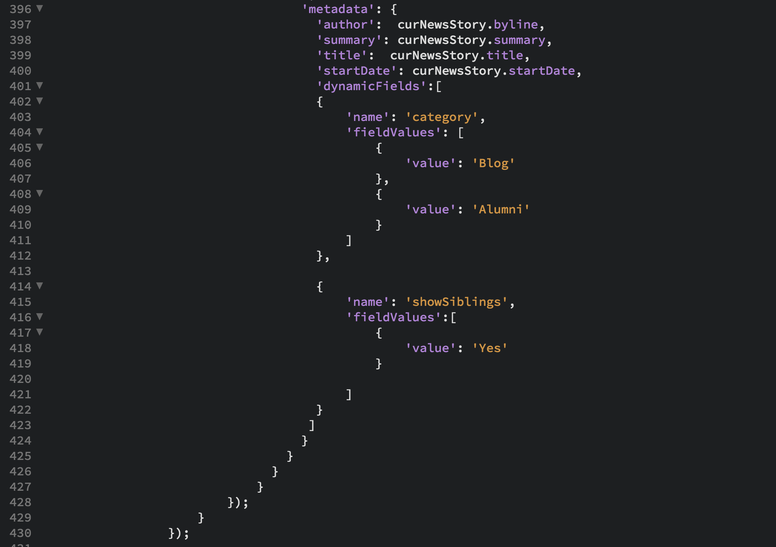

Slide 38
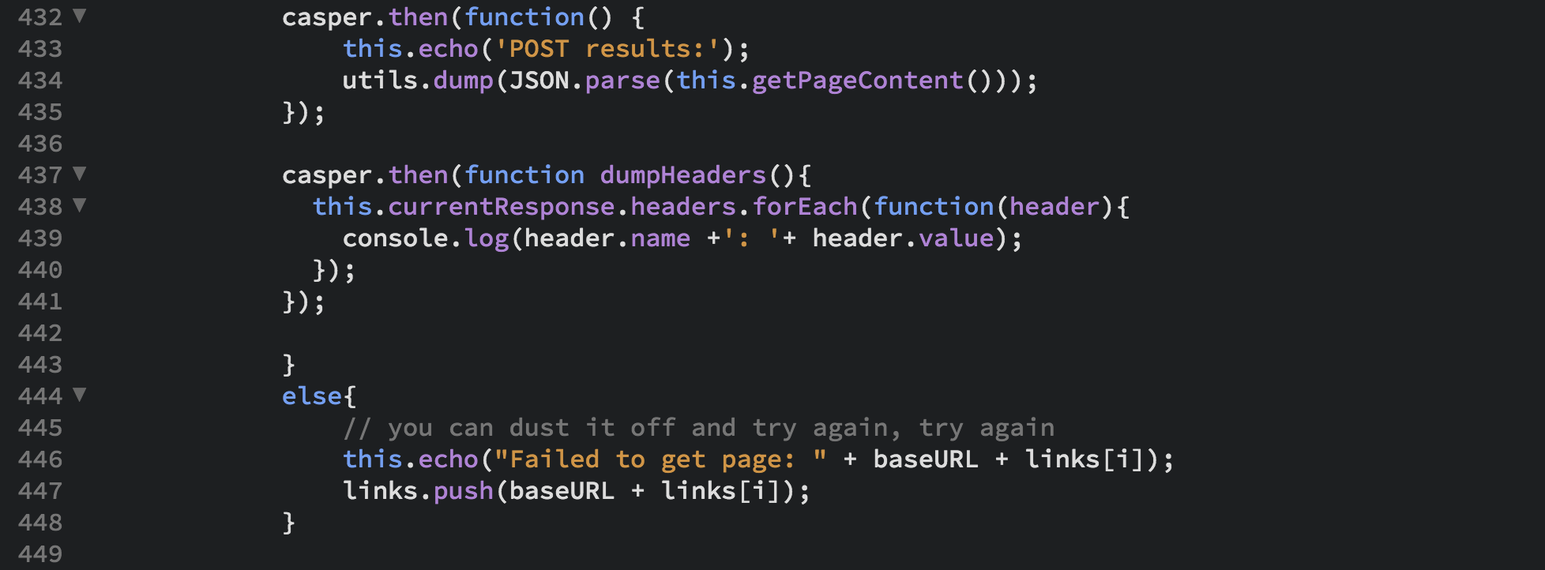

Slide 39
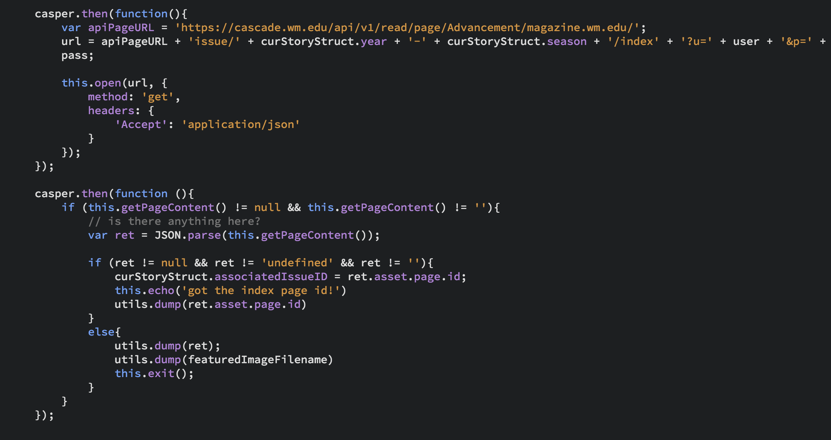

Slide 40
Not So Fast…
There’s a small workflow-related permissions bug in Web Services
Thanks to Andrew Bauserman & Tim from Hannon Hill for their assistance
You must do one of two things:
Have your Cascade administrator enable “Bypass all permissions checks” for this user, making them a global administrator (don’t do this)
Just turn off workflows for the folder you’re importing into (do this instead)

Slide 41
Okay, NOW Send It!
Do exactly one story first
This means stopping the CasperJS loop after the first story.
Dump as much to screen as you can
Once you’re sure you’ve got everything you want, delete your test stories and run the script
Don’t forget to publish!

Slide 42
Fun Notes
If you attempt to create a file that already exists, Cascade won’t throw an error or overwrite it — it’ll append a number to that file and merrily write away. You’ll never know.
Some fields want plain text. Some fields want HTML. You’ll quickly figure out which is which.

Slide 43

Q&A?
“Please don’t shoot the piano player; he is doing his best.”
Github: github.com/sflynn850/heweb18
email: sflynn@wm.edu
Twitter: @wxgeek

